Slide 1
PYTHON APPLICATION Food Order & Billing
18 – Apr – 2019
By Jahnavi, Harshitha, Sanya, Tina, Akhila, Priyanka

Slide 2
Executive Summary
Food Order & Billing Application primarily focuses on taking the order from the customer, generates the invoice and displays the rating of the service
Key Features covered in the program:
Classes / Objects
Docstrings
File Handling
Error and Exception Handling
Data Structures – Dictionaries
lambda function
String Manipulation

Slide 3


Details of the Program – Imports from Standard Library
datetime module is used to get current date & time
time module provides various time related function
sys module is used to manipulate run-time environment / interpreter
Sample Output

Slide 4
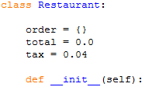
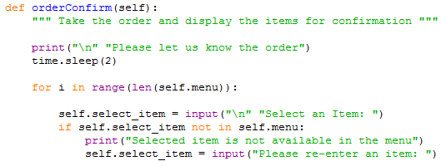
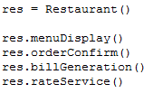
Details of the Program – Classes & Objects
Classes provide a blueprint using which objects are created.
Class methods have access to all the data contained in the instance of the object.

Slide 5
Details of the Program – Docstrings
Documentation strings are used for documentation purpose in methods / functions

Slide 6

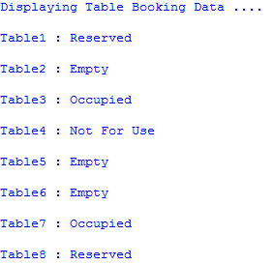
Details of the Program – Read File
Opens a table booking information file in read mode, prints the table availability
Sample Output

Slide 7
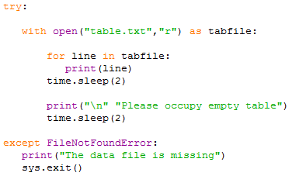

Details of the Program – Exception Handling
Exceptions are handled using try-except block
Exceptions to be handled in the program to avoid the program termination abruptly
Sample Output - FileNotFoundError

Slide 8
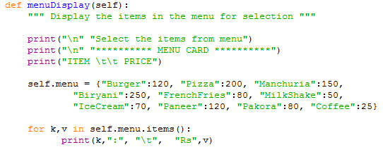
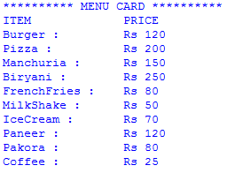
Details of the Program – Dictionaries
Sample Output
Dictionary is a data structure in which we store values as a pair of key and value.

Slide 9

Details of the Program – lambda function
Lambda function is a throw away function which can be used anywhere a function is required.
It can return just one value in the form of an expression

Slide 10
Details of the Program – String Manipulation
A string can be traversed by accessing characters from one index to another
replace() is an inbuilt string function which replaces a specified string with another specified string

Slide 11
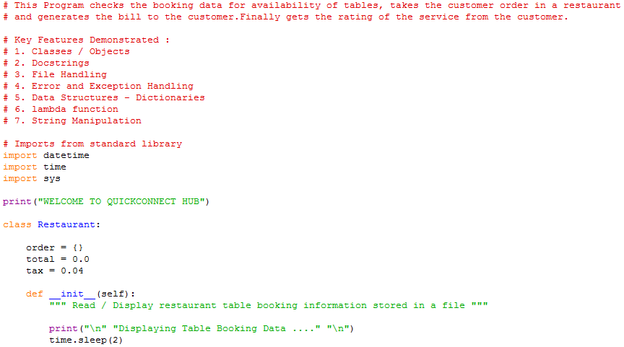
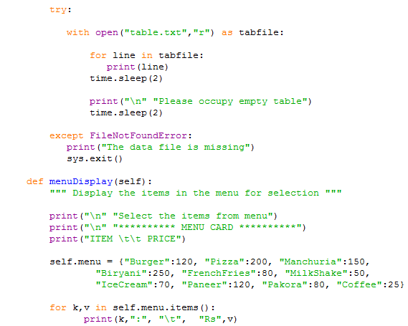
Appendix A – Source Code

Slide 12
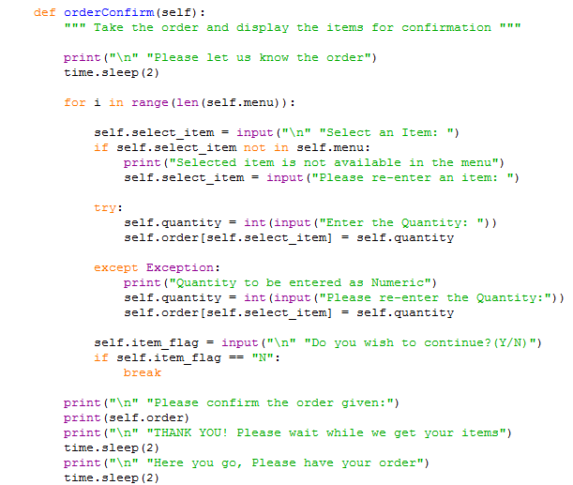
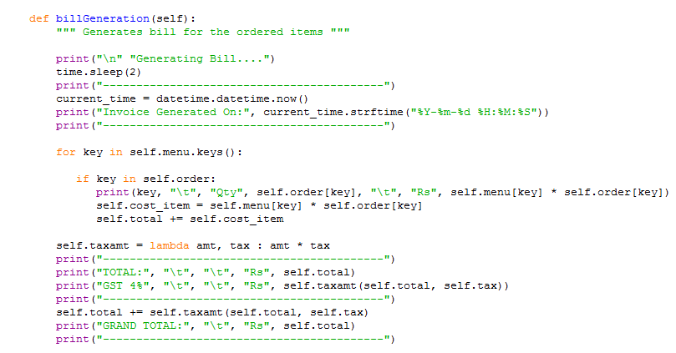
Appendix A – Source Code Cont’d

Slide 13
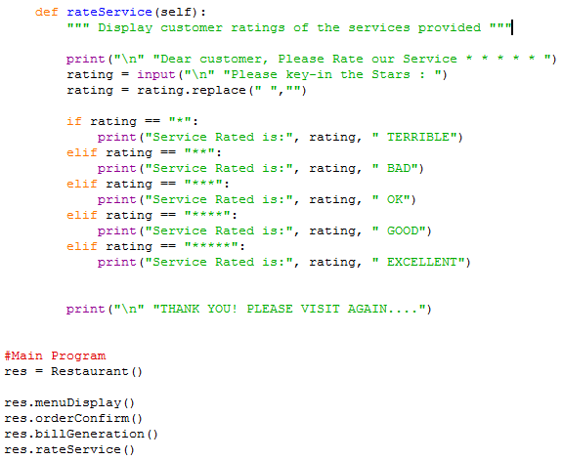
Appendix A – Source Code Cont’d

Slide 14
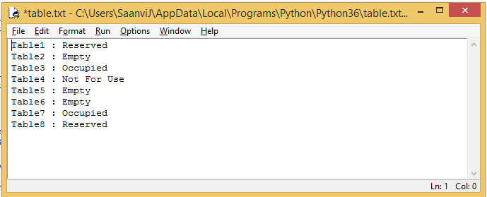
Appendix B – Table Data File

Slide 15
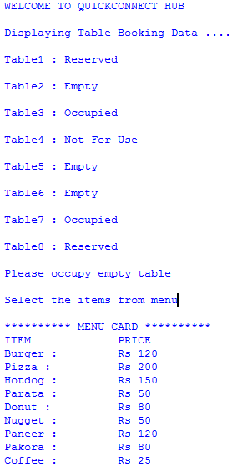
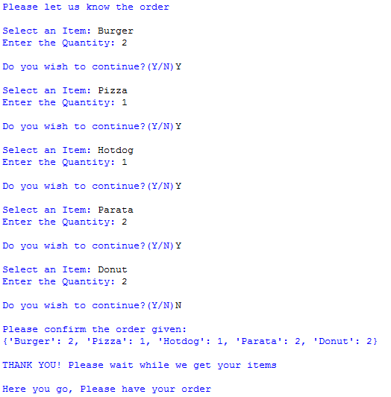
Appendix C – Output

Slide 16
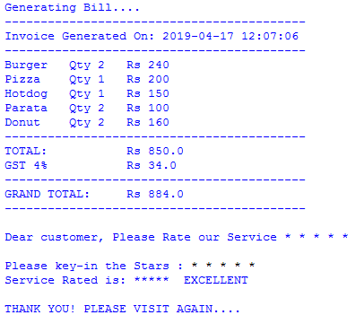
Appendix C – Output Cont’d

Slide 17
Q &A

Slide 18
Thank You

